Slide 1
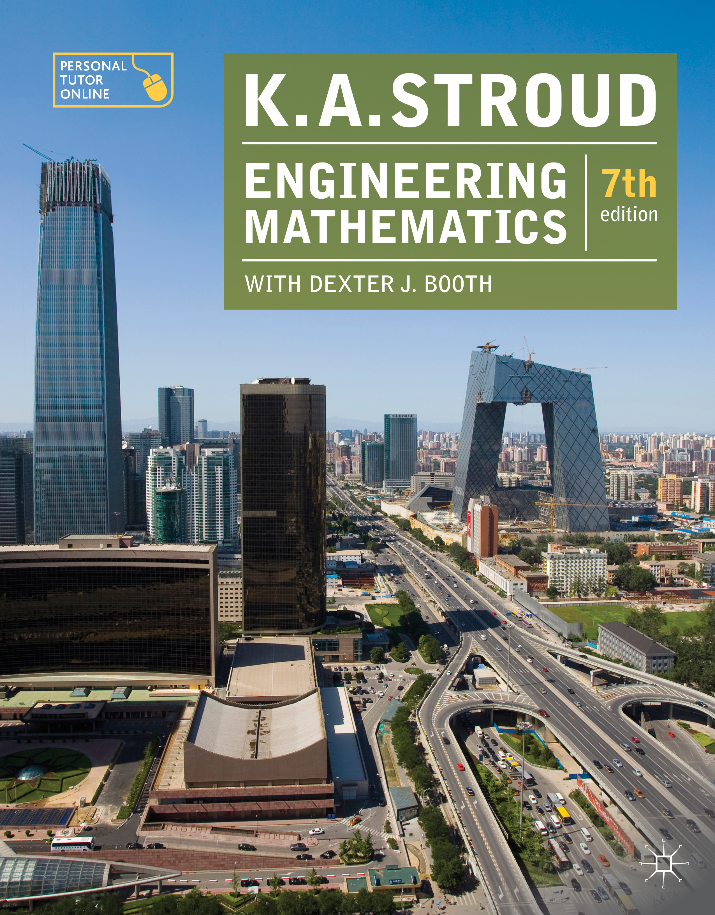
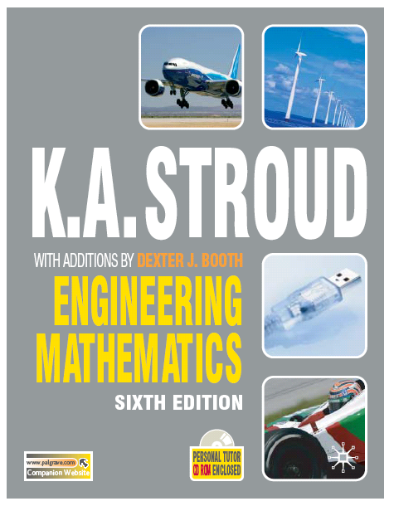
PROGRAMME 12
SERIES 2

Slide 2
Power series
Approximate values
Limiting values – indeterminate forms

Slide 3
Power series
Approximate values
Limiting values – indeterminate forms

Slide 4
Power series
Introduction
Maclaurin’s series
Standard series
The binomial series

Slide 5
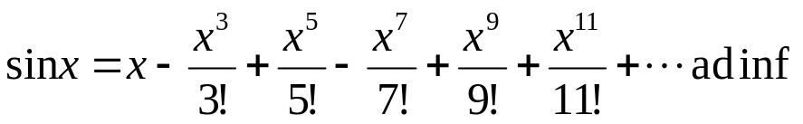
Power series
Introduction
When a calculator evaluates the sine of an angle it does not look up the value in a table. Instead, it works out the value by evaluating a sufficient number of the terms in the power series expansion of the sine. The power series expansion of the sine is:
This is an identity because the power series is an alternative way of way of describing the sine. The words ad inf (ad infinitum) mean that the series continues without end.

Slide 6
Power series
Introduction
What is remarkable here is that such an expression as the sine of an angle can be represented as a polynomial in this way.
It should be noted here that x must be measured in radians and that the expansion is valid for all finite values of x – by which is meant that the right-hand converges for all finite values of x.

Slide 7
Power series
Maclaurin’s series
If a given expression f (x) can be differentiated an arbitrary number of times then provided the expression and its derivatives are defined when
x = 0 the expression it can be represented as a polynomial (power series) in the form:
This is known as Maclaurin’s series.

Slide 8
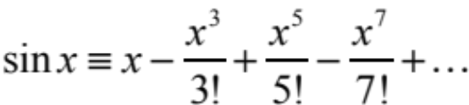
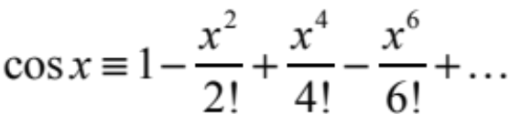
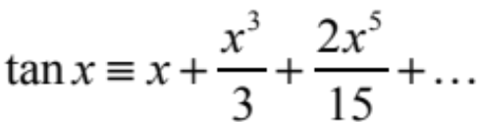
Power series
Standard series
The Maclaurin series for commonly encountered expressions are:
Circular trigonometric expressions:
valid for −θ/2 < x < θ/2

Slide 9
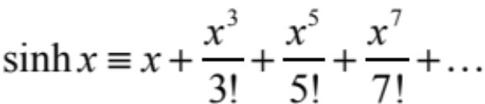
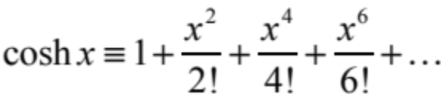
Power series
Standard series
Hyperbolic trigonometric expressions:

Slide 10
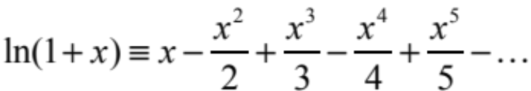
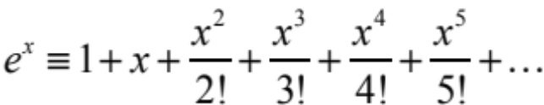
Power series
Standard series
Logarithmic and exponential expressions:
valid for −1 < x < 1
valid for all finite x

Slide 11
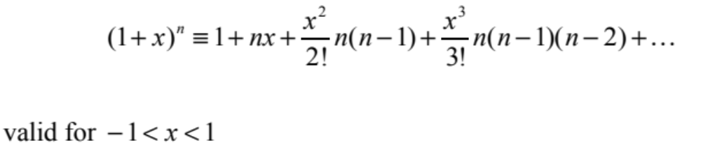
Power series
The binomial series
The same method can be applied to obtain the binomial expansion:

Slide 12
Power series
Derivatives and several rules
Limiting values – indeterminate forms

Slide 13
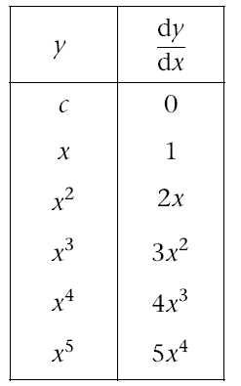
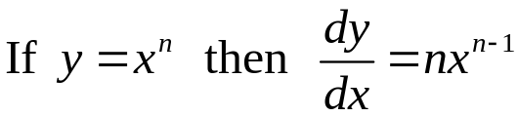
Derivatives of powers of x
A clear pattern is emerging:

Slide 14
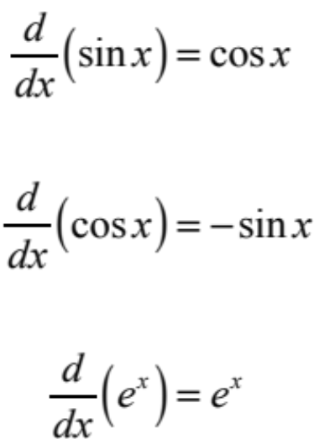
Standard derivatives and rules
Standard derivatives
The table of standard derivatives can be extended to include trigonometric and the exponential functions:

Slide 15

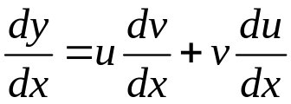

Differentiation of products of functions
Given the product of functions of x:
then:
This is called the product rule.
For examples

Slide 16
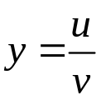
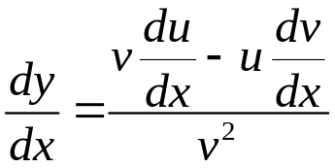
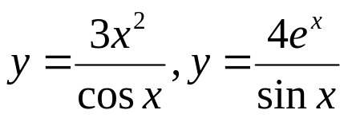
Differentiation of a quotient of two functions
Given the quotient of functions of x:
then:
This is called the quotient rule.
For examples

Slide 17

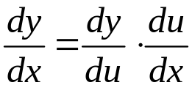

Functions of a function
Differentiation of a function of a function
To differentiate a function of a function we employ the chain rule.
If y is a function of u which is itself a function of x so that:
Then:
This is called the chain rule.
For examples

Slide 18
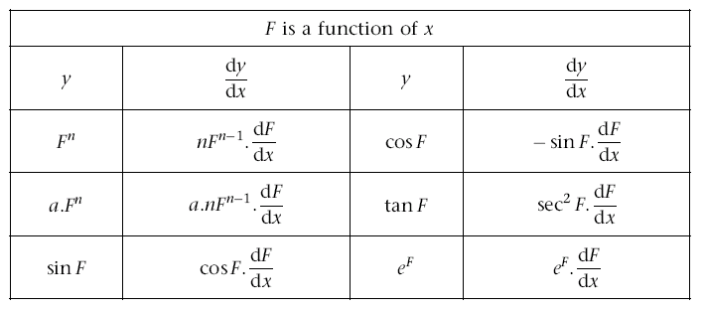
Functions of a function
Differentiation of a function of a function
Many functions of a function can be differentiated at sight by a slight modification to the list of standard derivatives:

Slide 19

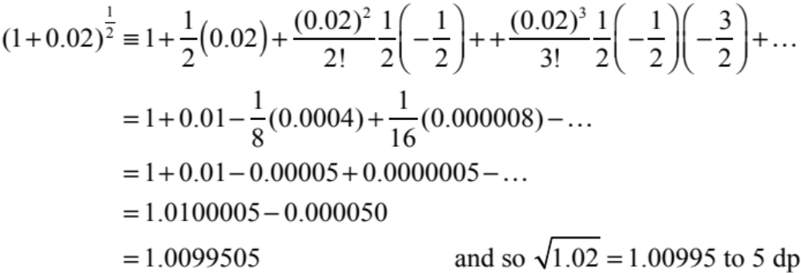
Approximate values
The Maclaurin series expansions can be used to find approximate numerical values of expressions. For example, to evaluate correct to 5 decimal places:

Slide 20
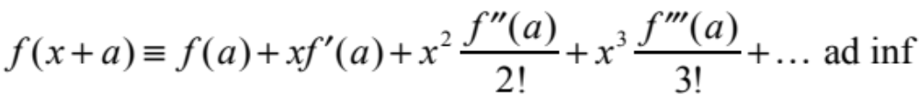
Approximate values
Taylor’s series
Maclaurin’s series:
gives the expansion of f (x) about the point x = 0. To expand about the point x = a, Taylor’s series is employed:

Slide 21
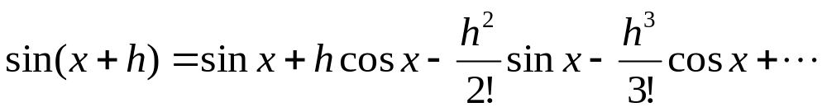
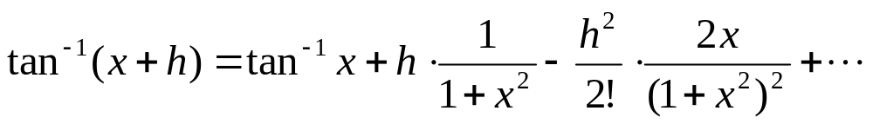
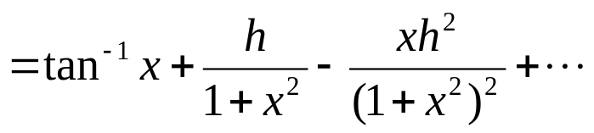
For examples, to expamd the following functions as s series of h

Slide 22
Power series
Approximate values
Limiting values – indeterminate forms

Slide 23
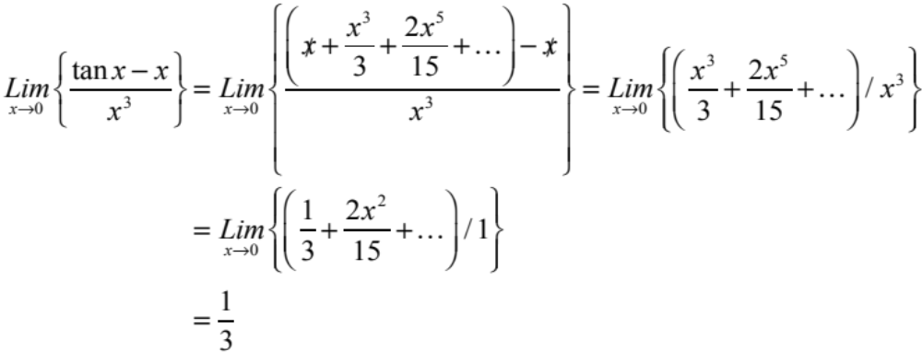
Limiting values – indeterminate forms
Power series expansions can sometimes be employed to evaluate the limits of indeterminate forms. For example:

Slide 24
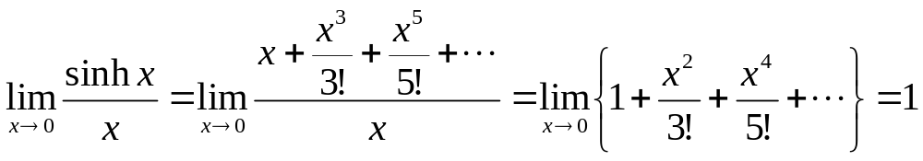
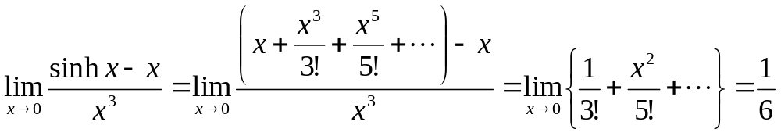
For examples, to replace functions by its powers of x

Slide 25
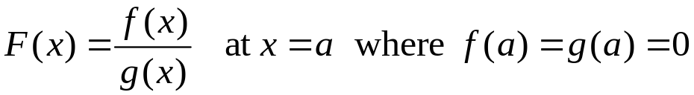
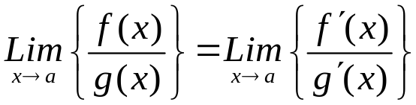
Limiting values – indeterminate forms
L’Hôpital’s rule for finding limiting values
To determine the limiting value of the indeterminate form:
Then, provided the derivatives of f and g exist:
This is known as L’Hôpital’s rule

Slide 26
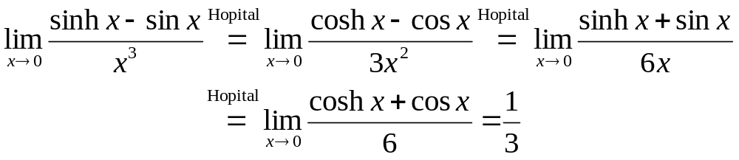
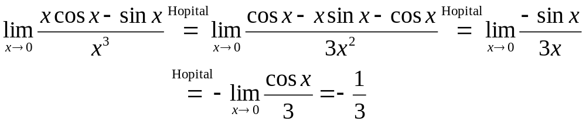
For examples, to find limit of indeterminate forms (by L Hopital's Rule)

Slide 27
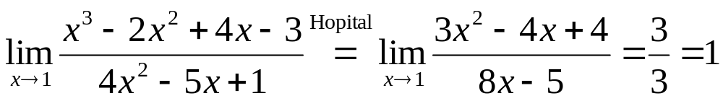
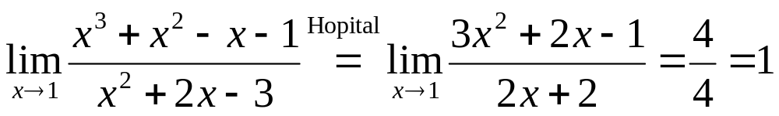
For examples, to find limit of indeterminate forms (by L Hopital's Rule)
Second equality Is Not indeterminate form.

Slide 28
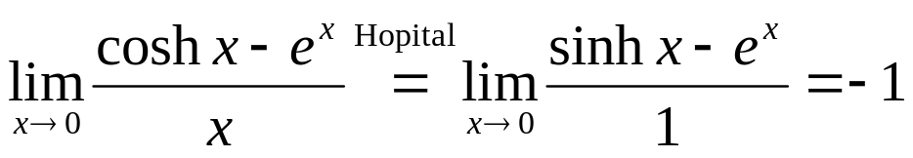
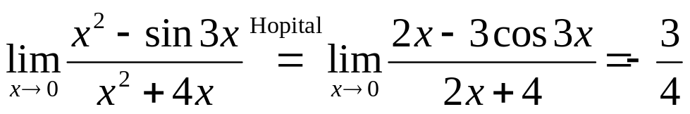
Your exercises, to find limit of indeterminate forms (by L Hopital's Rule)

Slide 29
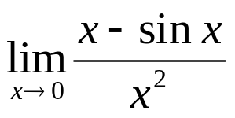
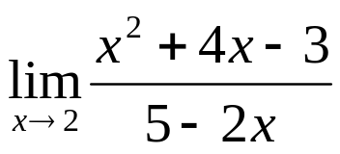
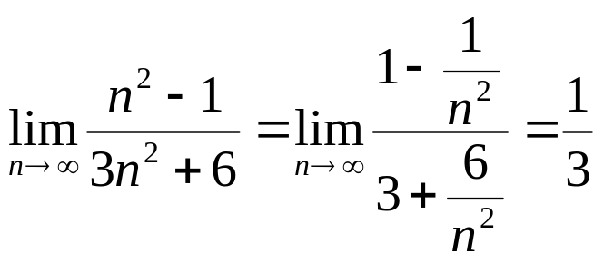
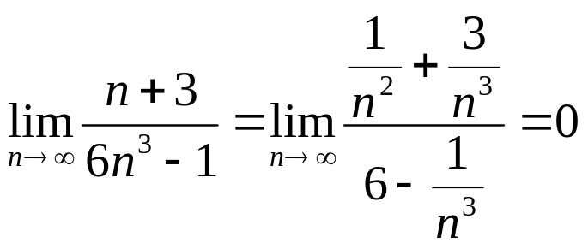
Exercises, to find limit of indeterminate forms (by L Hopital's Rule)
But, for cases n approaches infinity, we pick highest power and devide as follows:

Slide 30
Learning outcomes
Derive the power series for sin x
Use Maclaurin’s series to derive series of common functions
Use Maclaurin’s series to derive the binomial series
Derive power series expansions of miscellaneous functions using known expansions of mcommon functions
Use power series expansions in numerical approximations
Use l’Hôpital’s rule to evaluate limits of indeterminate forms
Extend Maclaurin’s series to Taylor’s series

